Slide 1
License Plates
Naomi Liftman, Oviya Muralidharan, and Eva Reutercrona
Notes:
Nyooom

Slide 2
Table of Contents
3
8
Lessons Learned
Background
4
9
Questions
Data Used
5
Use Cases
6
Design
7
Demo

Slide 3
Background
License Plates
Data 515
Goal for project outcome: A tool that the state of California could use to identify if plates should be rejected or accepted.
Current State:
All license plate approvals must be done manually.
Drivers only way of checking is with restrictions on website or submission.
Notes:
Nyoom

Slide 4
Data Used
License Plates
Data 515
California License Plate Master
Twitter English Profanity Set
Carnegie Mellon: Bad Word txt
Wikipedia: Ethnic Slurs
GitHub: List of English Naughty Words
GitHub: English Profanity CSV
Chew Inclusive Terminology Glossary: Contemporary Slurs
Notes:
nyoom
What data was used
How was it obtained
Limitations

Slide 5
Use Case 1: Single Valid Plate Review
License Plates
Data 515
Objective: Determine whether a proposed plate contains restricted material.
User: Enters a license plate into the interface.
System: Validates the plate format and checks for offensive or restricted content.
Outcome: Displays that the plate does not contain restricted language.
Notes:
How users will interact with your system in a way that addresses the problem area.

Slide 6
Use Case 2: Single Rejected Plate Review
License Plates
Data 515
Objective: Explain why a plate is not allowed.
User: Enters a license plate into the interface.
System: Validates the plate format and checks for offensive or restricted content.
Outcome: Displays that the plate contains restricted language.
User: Clicks the “More Information” button.
System: Displays the reason for rejection, such as invalid format, restricted letter combination, or similarity
Notes:
How users will interact with your system in a way that addresses the problem area.

Slide 7
Use Case 3: Batch DMV Review
License Plates
Data 515
Objective: Screen many license plates at once.
User: Uploads a CSV containing license plates.
System: Processes each plate, validates format, and checks for offensive or restricted content.
Outcome: Returns a CSV containing the original data plus three additional columns:
acceptance: accepted or denied
rationale: blank for accepted plates, “invalid” for formatting issues, or an explanation for flagged content
notes: additional information for flagged content
Notes:
How users will interact with your system in a way that addresses the problem area.

Slide 8
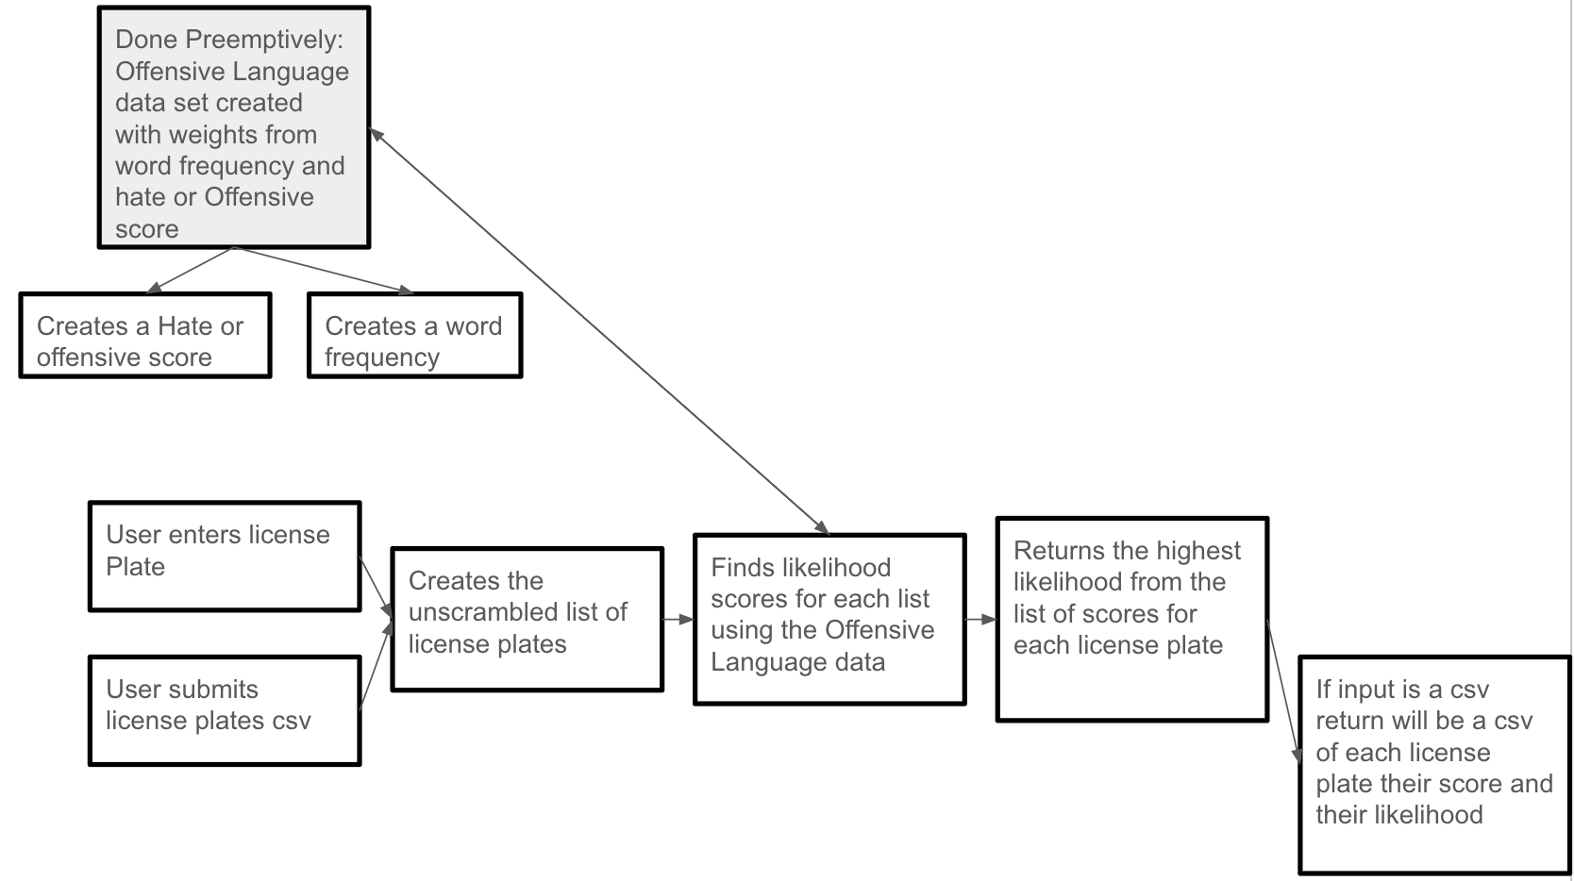
Design
License Plates
Data 515
Notes:
Change this slide to something better: Couple of bullet points or something MAYBE? NAOMI SAYS IT’S OKAY

Slide 9
Design
License Plates
Data 515
User Input (plate/csv)
Plate preprocessing
(normalization + substitutions)
Offensive word detection
Exact substring matching
Fuzzy similarity matching
Single Plate
shows restricted words
shows explanation in Streamlit UI
Offensive Language Dataset
(word frequency + hate score)
Scoring engine
Number of tweets word appears in
Hate vs offensive
CSV Input
applies decision rules
adds columns:
approval
rationale
returns processed CSV
Notes:
Change this slide to something better: Couple of bullet points or something MAYBE? NAOMI SAYS IT’S OKAY
Scoreing engine: number of tweet

Slide 10
Project Takeaways & Direction
License Plates
Data 515
Lessons Learnt
Future Work
Many leetspeak encoders but few leetspeak decoders
Twitter is not the all encompassing resource of ethnic slurs
The difficulties of testing streamlit
Pro’s and Con’s of GitHub Multiple Reviewers
Expand the offensive language dataset
Improve word detection algorithms
Improve phrase detection
Notes:
Must be software engineering lessons

Slide 11
Link to Demo!
License Plates
Data 515
Notes:
Have screen recording as a back up for the demo

Slide 12
Questions?
License Plates
Questions?

